Slide 1
Containers, Docker, and Microservices
Efficient deployment of self-contained services

Slide 2
You can put all your Microservices into containers
And more: couple containers to your CI/CD system, use resource managers to manage them.
API Server
Application Manager
Metadata Server
API Server
API Server
API Server
API Server
Application Manager
Metadata Server
Application Manager
Metadata Server
Application Manager
Metadata Server
Application Manager
Metadata Server
Application Manager
Metadata Server
Application Manager
Metadata Server

Slide 3
Hypervisor Virtualization
Hypervisors provide software emulated hardware and support multiple OS tenants.
Type 1 Hypervisors run directly on the hardware
Kernel-based Virtual Machine (KVM)
Xen: Amazon uses (or used) this
Type 2 Hypervisors run as another program in the HostOS
Virtual Box
VMWare

Slide 4
Drawbacks to Using Hypervisors
Virtual Machines using hypervisors access virtual hardware.
This allows VMs to run a wide range of guest operating systems.
But it adds overhead
VMs take a long time to startup.
Performance is worse: software-emulated hardware
VMs take up a lot of resources. Limited number of VMs can run on the real hardware

Slide 5
Operating System (OS) Virtualization
The OS can run other OS instances as separate processes.
No hardware virtualization or emulation.
Tenants share the OS kernel with the host OS.
The guest (tenant) OS instances are shielded from each other.
This limits the OS options for the tenants
But performances is much greater
And you can fit a lot more OS VMs onto the host.
But not as secure as Hypervisor Virtualization

Slide 6
Linux Containers (LXC)
Cgroups: a Linux kernel feature that limits, accounts for, and isolates the resource usage (CPU, memory, disk I/O, network, etc.) of a collection of processes.
Cgroups lets you carve up the hardware into continuous, resizable pieces
Namespace Isolation: groups of processes are separated such that they cannot "see" resources in other groups.
For example, a PID namespace provides a separate enumeration of process identifiers within each namespace
Shield container processes from the host and other containers’ processes.
https://en.wikipedia.org/wiki/Cgroups

Slide 7
Container Takeaways
When combined, cgroups and namespace isolation let you run much lighter weight VMs.
Less resource usage overhead for running VMs
VMs can start and stop much more quickly
You can do further tricks to optimize containers.
You may be able to run many containers on a single VM

Slide 8
Hmm, when would I need to run lots of little containers...?
Microservices

Slide 9
Docker 101
Wrapping your Microservices in Containers

Slide 10
What is Docker?
Docker packages LXC and other tools to make creating and using images easy, standardized
No more DIY containers
You can run Docker on Linux desktops and servers.
Other OS’s can run Docker inside a VM
MacOS: Use Virtual Box to run a Linux flavor

Slide 11
Example: Set up a MySql Database
docker run --name db --detach --env MYSQL_ROOT_PASSWORD=123 --publish 4407: 3306 mysql:latest
This creates a container named “db”
The container runs in the background (--detach)
We pass the environment variable MYSQL_ROOT_PASSWORD to the container.
The container maps the host’s port 4407 to its internal port 3306 (--publish)
3306 is the default MySQL port.
We run the image mysql:latest
The command returns with a UID for our image.

Slide 12
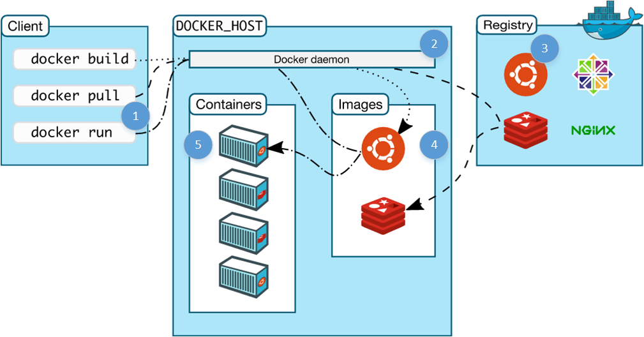
What Happens (1/2)?

Slide 13
What Happens (2/2)?
The client command contacts the Docker daemon on your local host.
Docker daemon looks for an image named “mysql-latest”.
Your local repository
DockerHub
If necessary, the image is copied to your local repository.
The image is used to create an running container instance.

Slide 14
What Happens if I Run the Command Again
Give the container a different name (“db2”)
Change the --publish external port to use something besides 4407.
You’ll get another MySQL DB identical to the first.
Do it again. You can quickly bring up multiple independent, isolated MySQL DBs on your laptop.

Slide 15
What’s Next?
You can now connect to your image and run MySQL startup scripts through an interactive shell.
docker exec -it db /bin/bash: you get a command prompt
Remember: “db” is the name of the instance.
But this is not the best way to do your specific configurations.

Slide 16
Make Your Own Images
Use the “docker build” command to create your own images.
Use a Dockerfile to specify exactly how you want your image to be created.
See next slide
Save your image to a repository after you build it with “docker push”
You don’t need to run “docker build” every time
See “Docker Hub” in a couple of slides.

Slide 17
# A basic apache server. To use either add or bind mount content under /var/www
FROM ubuntu:12.04
MAINTAINER Kimbro Staken version: 0.1
RUN apt-get update && apt-get install -y apache2 && apt-get clean && rm -rf /var/lib/apt/lists/*
ENV APACHE_RUN_USER www-data
ENV APACHE_RUN_GROUP www-data
ENV APACHE_LOG_DIR /var/log/apache2
ADD ./index.html /var/www/html/
EXPOSE 80
CMD ["/usr/sbin/apache2", "-D", "FOREGROUND"]
https://github.com/kstaken/dockerfile-examples

Slide 18
Keyword | Description
FROM | The base image to use
RUN | Execute these commands on the base image and make a new image.
ENV | Set image-wide environment variables; these can also be used by other elements of the Dockerfile
CMD | Executes the specified command. Use this to start services.
ADD | Copies all specified files and directories from the host to the image.
EXPOSE | Specifies the ports that the container will listen to
Some Dockerfile commands

Slide 19
Docker Hub
Docker Hub is a repository for Docker images.
You interact with it a lot like GitHub
docker push command pushes a local image to Docker Hub
Ex: docker push yourUserName/gateway-service-X will push a local image named “yourUserName/gateway-service-X” to Docker Hub.
You need to use Docker tags and namespaces to do this correctly.
You can check out your own images anywhere
Run docker run yourUserName/gateway-service-X on Travis-CI, for example
Use Docker Hub to also get common images from trusted providers
“docker search”
You can connect your images to GitHub repos to trigger automatic builds if you have a build file.

Slide 20
Make Multiple Containers
You can now create another container to run a Web server and connect to your DB.
Use your favorite technology
Node.js, Tomcat + JSP, PHP, etc.
You could also choose to run both the web application and the DB in the same container.
Which is better?

Slide 21
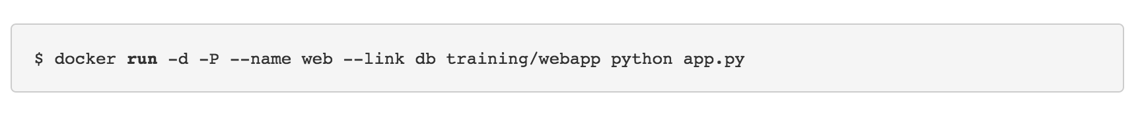
Connecting Containers
Use linking to allow containers to communicate with each other securely without exposing ports.
A linked container shares its environment variables
Link: the db doesn’t need to expose a port #

Slide 22
Composing Containers
Docker Compose is a tool for defining and running multi-container Docker applications.
Docker Compose lets you specify in a single YAML file how to create all the containers you need on a single host.
docker-compose build: creates instances for all the images specified in docker-compose.yml

Slide 23
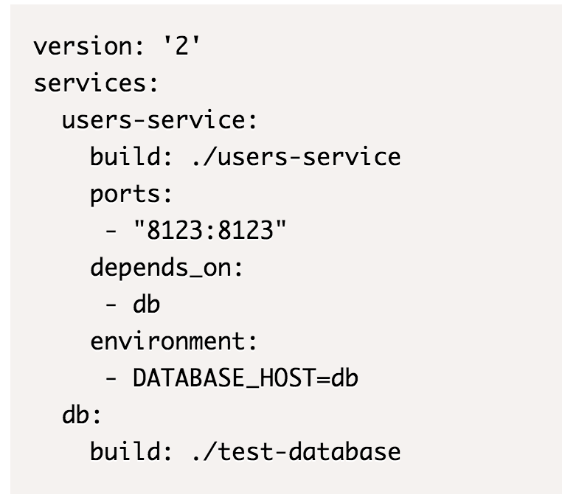
Example docker-compose.yml
This example creates 2 services
users-service
db
build: this tells Docker Compose where to find the Dockerfile.
Note users-service depends on db
docker-compose up will start all the services.

Slide 24
Data Volumes and the Storage Driver
When a container is deleted, any data written to the container that is not stored in a data volume is deleted along with the container.
A data volume is a directory or file in the Docker host’s filesystem that is mounted directly into a container.

Slide 25
Docker volumes allow containers to mount the host’s file system.

Slide 26
$ docker run -d -P --name web -v /data:/data training/webapp python app.py
This will mount the host’s /data directory to the /data directory in the container.

Slide 27
Dangerous Waters
Mounting the host’s file system should be done with care.
Containers owned by different users can access each other’s data.
You can accidentally give the container too many privileges on the host’s file system.
State gets bound to a specific host.
This is where VMs can help

Slide 28
Docker Big Picture
Some slides courtesy of http://www.slideshare.net/dotCloud/docker-intro-november

Slide 29
Docker
Docker replaces the need for DIY containers
Docker uses LXC containerization + AuFS
AuFS lets Docker containers share common files
AuFS also allows you to have efficient version control of container images
Because each container has its own thin writable container layer, and all changes are stored in this container layer, multiple containers can share access to the same underlying image and yet have their own data state.

Slide 30
Docker Goals
Package an application and all its dependencies in a single container.
Shield applications from host OS dependencies
Shield applications from other applications’ conflicting dependencies.
Provide standard docker images for common applications.
Allow you to assemble containers into composite applications

Slide 31
Docker and Microservices
You can pack a lot of docker containers into a host computer without adding a lot of virtualization overhead.
Sounds like a good fit for microservices.
One microservice per container

Slide 32

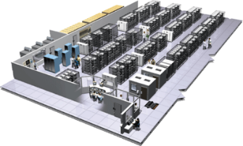
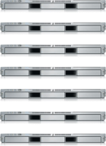
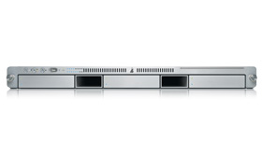
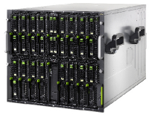
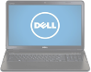
The Challenge
User DB
Static website
postgresql + pgv8 + v8
Queue
Analytics DB
nginx 1.5 + modsecurity + openssl + bootstrap 2
Do services and apps interact appropriately?
Redis + redis-sentinel
hadoop + hive + thrift + OpenJDK
Multiplicity of Stacks
Background workers
Web frontend
Python 3.0 + celery + pyredis + libcurl + ffmpeg + libopencv + nodejs + phantomjs
Ruby + Rails + sass + Unicorn
API endpoint
Python 2.7 + Flask + pyredis + celery + psycopg + postgresql-client
Production Cluster
Development VM
Public Cloud
Multiplicity of hardware environments
QA server
Can I migrate smoothly and quickly?
Disaster recovery
Customer Data Center
Contributor’s laptop
Production Servers

Slide 33
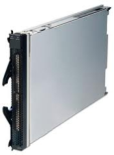
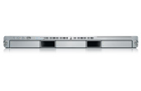
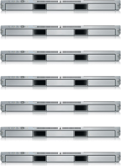

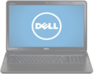
The Matrix From Hell
? | ? | ? | ? | ? | ? | ?
? | ? | ? | ? | ? | ? | ?
? | ? | ? | ? | ? | ? | ?
? | ? | ? | ? | ? | ? | ?
? | ? | ? | ? | ? | ? | ?
? | ? | ? | ? | ? | ? | ?
Static website
Web frontend
Background workers
User DB
Analytics DB
Queue
 | Development VM | QA Server | Single Prod Server | Onsite Cluster | Public Cloud | Contributor’s laptop | Customer Servers

Slide 34

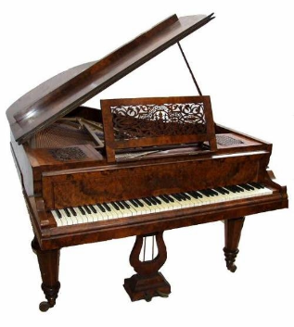

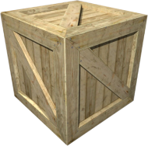
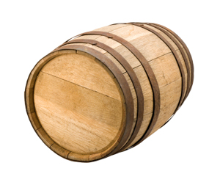
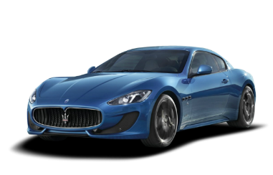
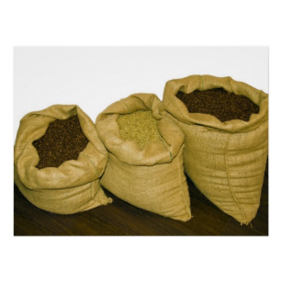



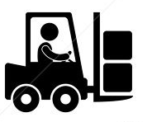
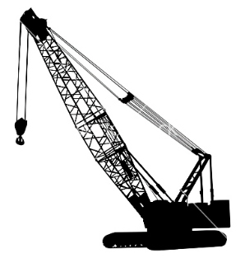
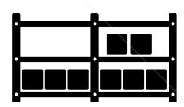

Cargo Transport Pre-1960
Do I worry about how goods interact (e.g. coffee beans next to spices)
Multiplicity of Goods
Multipilicity of methods for transporting/storing
Can I transport quickly and smoothly
(e.g. from boat to train to truck)

Slide 35


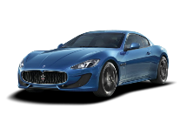


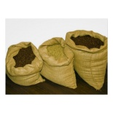


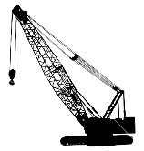



A matrix from hell
 | ? | ? | ? | ? | ? | ? | ?
 | ? | ? | ? | ? | ? | ? | ?
 | ? | ? | ? | ? | ? | ? | ?
 | ? | ? | ? | ? | ? | ? | ?
 | ? | ? | ? | ? | ? | ? | ?
 | ? | ? | ? | ? | ? | ? | ?

Slide 36
It is a combinatorial problem
Combinatorial problems can be solved in a classic fashion

Slide 37

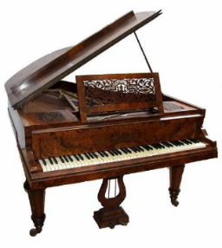

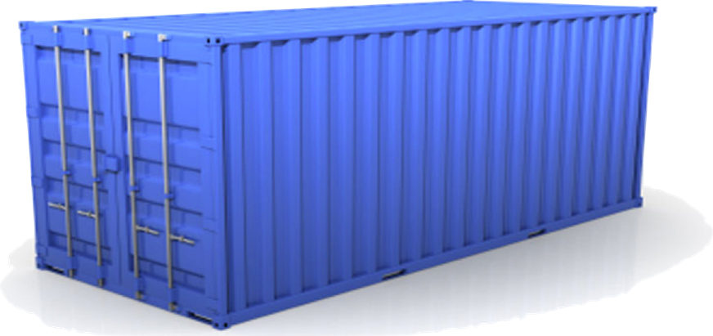
Solution: Intermodal Shipping Container
Do I worry about how goods interact (e.g. coffee beans next to spices)
Multiplicity of Goods
A standard container that is loaded with virtually any goods, and stays sealed until it reaches final delivery.
…in between, can be loaded and unloaded, stacked, transported efficiently over long distances, and transferred from one mode of transport to another
Can I transport quickly and smoothly
(e.g. from boat to train to truck)
Multiplicity of methods for transporting/storing

Slide 38
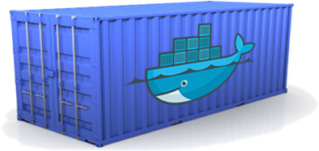
Docker is a shipping container system for code
Static website
User DB
Web frontend
Queue
Analytics DB
Do services and apps interact appropriately?
Multiplicity of Stacks
An engine that enables any payload to be encapsulated as a lightweight, portable, self-sufficient container…
…that can be manipulated using standard operations and run consistently on virtually any hardware platform
Multiplicity of hardware environments
Can I migrate smoothly and quickly
Development VM
QA server
Customer Data Center
Public Cloud
Production Cluster
Contributor’s laptop

Slide 39
Containers vs. Virtual Machines

Slide 40
Why are Docker containers lightweight?
VMs
Containers
App
A
App
A
App
A’
App
A
App
A
App Δ
Bins/
Libs
Bins/
Libs
Bins/
Libs
Bins/
Libs
Bins/
Guest
OS
Guest
OS
Guest
OS
Guest
OS
Original App
(No OS to take
up space, resources,
or require restart)
Copy of
App
No OS. Can
Share bins/libs
Modified App
Copy on write capabilities allow
us to only save the diffs
Between container A and container
A’
VMs
Every app, every copy of an
app, and every slight modification
of the app requires a new virtual server
LXC enables this
AuFS enables these

Slide 41
Changes and Updates
https://docs.docker.com/storage/storagedriver/
Docker
Container
Image Registry
App
A
Push
App Δ
Bins/
Libs
Bins/
Base
Container
Image
Container Mod A’
Container Mod A’’
App Δ
Update
App
A
Bins/
App
A’’
Bins/
Libs
Bins/
Libs
Bins/
Docker Engine
Docker Engine
Host is now running A’’
Host running A wants to upgrade to A’’. Requests update. Gets only diffs

Slide 42
Docker: Infrastructure as Code
In short, Docker lets you define in script files everything about each of your microservices.
Combine this with CI/CD systems to deploy EACH microservice.
Your development to test to production environments should be identical and reproducible.
Testing and production deployments for each service should be infinitely clone-able.
This is not elasticity, but it is a prerequisite.
Docker and other containers have much less overhead

Slide 43
You can put all your Microservices into containers
API Server
Next, we will look at how to spin all of this up and keep it running
Application Manager
Metadata Server
API Server
API Server
API Server
API Server
Application Manager
Metadata Server
Application Manager
Metadata Server
Application Manager
Metadata Server
Application Manager
Metadata Server
Application Manager
Metadata Server
Application Manager
Metadata Server

